Slide 1
PARTNERING FOR PROACTIVE REGULATION

Slide 2
What we will cover:
Realtors and regulation
The history and evolution of organized real estate
Reactive regulation
Opportunities for regulators to be more proactive
A hypothetical scenario that won’t happen but could

Slide 3
Realtors
and
Regulation

Slide 4
What do you regulate?
Property?
People?
Actions?
Transactions?

Slide 5
“Organized real estate supports the idea of holding our profession, and those that are in it, to a high enough account that the public feels safe and supported while they navigate the single largest transaction of their lives.”

Slide 6
History
and Evolution

Slide 7
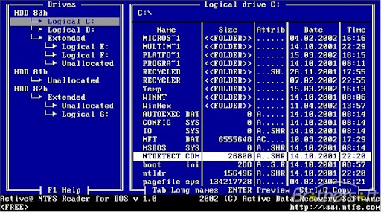

Slide 8
Data historically collected
A list of data historically collected by real estate MLS® Systems:
Property data
Sold data

Slide 9
Data currently collected
A list of data currently collected by real estate MLS® Systems:
Property data
Sold data

Slide 10
Data collected by non-MLS® groups
Data currently collected by non-MLS® Groups:
Property data
Sold data

Slide 11
What other data is there?
Transaction data
Consumer trends

Slide 12
“Innovation and creativity must remain the focus of anyone in a leadership position who can influence the mandate of organized real estate.”

Slide 13
Reactive
Regulation

Slide 14
External Impact
(market conditions,
consumer expectations, etc.)
Government reacts
Regulator reacts
Industry reacts

Slide 15
“Willingness to embrace new realities will help us adapt to a changing world. Because of the inherent nature of government, regulators can be reactionary. Whether we like it or not, technology has changed the way consumers do everything.”
- MiChell Bird

Slide 16
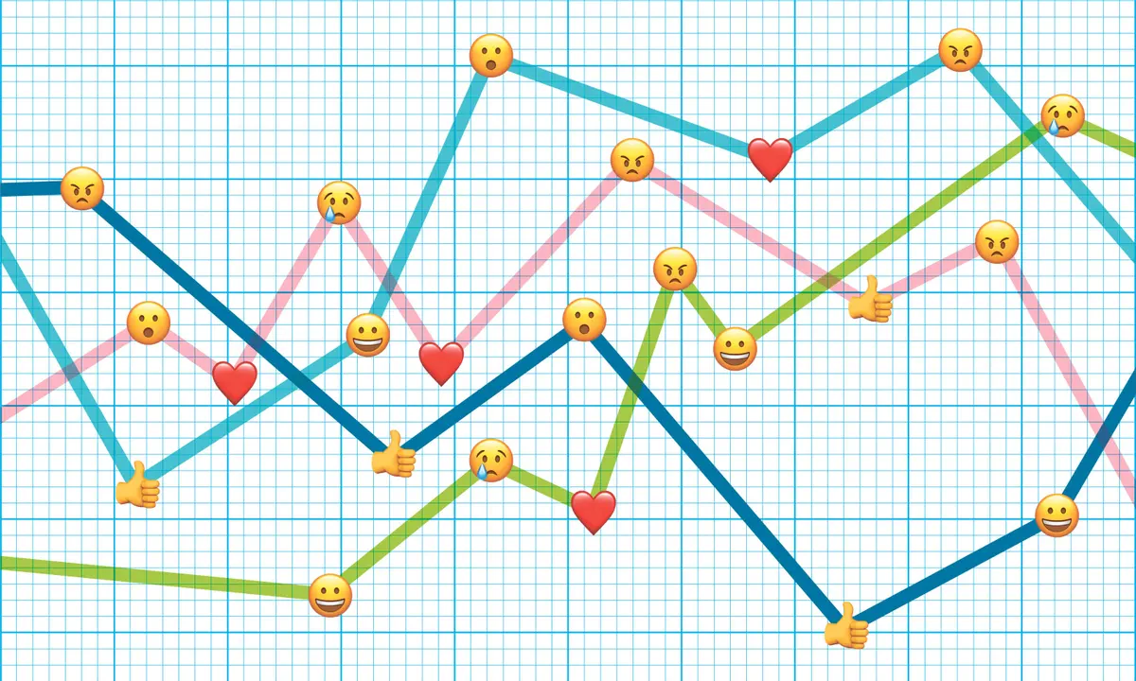
“Don’t bring feelings to a data fight”
- Jeanette Renshaw

Slide 17
Becoming
Proactive

Slide 18
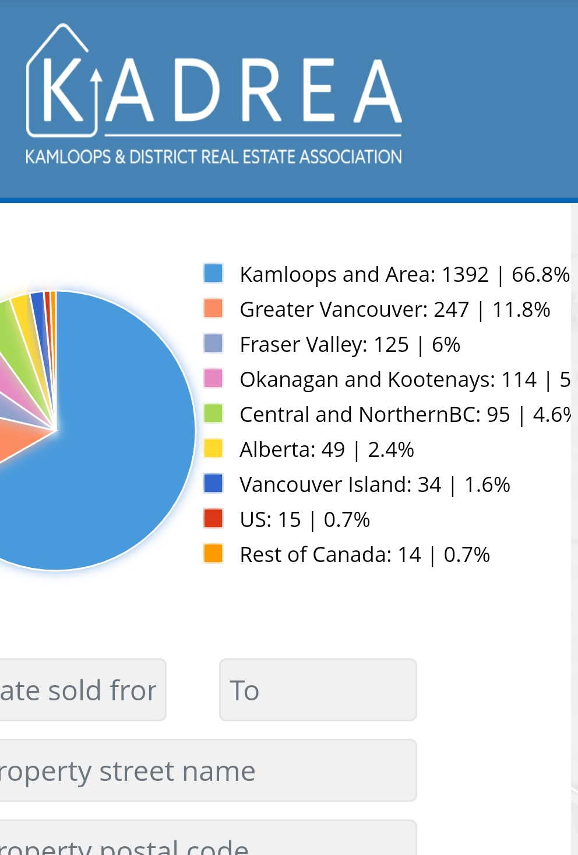
Buyer Path

Slide 19
Privacy
Data Collection
Data aggregation
Non-identifying data

Slide 20
Regulators and data
Regulators increasingly interested in data
Not just real estate
Regulators could just write policy to require data sharing
AI reforming Ohio’s regulatory landscape

Slide 21
2022 data call
Frequency of multiple offers
Prevalence of unconditional offers
Difference between asking and sale price
Difference between accepted price and next highest offer

Slide 22
So, what do we have?
Collecting the same data
Opportunity to collect new data points
Regulators can partner with industry
Create data/research informed policy
Achieve proactive regulation

Slide 23
Hypothetical
Scenario

Slide 24
Hypothetical scenario
A new MLS® System
Built on machine learning and predictive analytics
Populated with every data point collected or touched by Realtors®
Governed by business rules that apply parameters from both industry and regulator

Slide 25
Questions?

